Slide 1
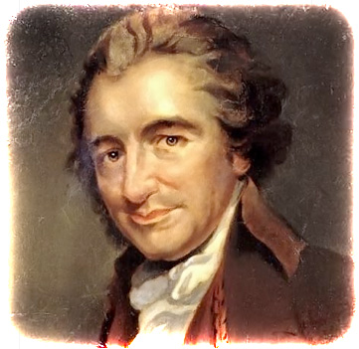
Thomas Paine

Slide 2
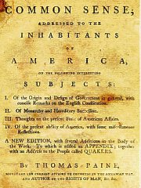
Background
Born in England on January 29, 1737
Emigrated to American in 1774 and settled in Philadelphia, Pennsylvania, just in time to take part in the American Revolution
Wrote Common Sense, a persuasive pamphlet that advocated American independence from Great Britain; often credited with turning the tide of public opinion in favor of independence
Considered a radical intellectual with an ability to present complex ideas in clear and concise language

Slide 3
Background cont’d
Served (1777–1779) as secretary to the committee on foreign affairs of the Continental Congress, and in 1779 was named clerk of the Pennsylvania assembly
Went to Great Britain in 1787. While there, Paine wrote The Rights of Man (1791) defending the French revolution and calling on the English to overthrow their monarchy and form a republic. In 1792, he was tried, convicted of treason, and outlawed from England. After being outlawed from England, he moved to France.
Other works include The Age of Reason (Part I, 1794; Part II, 1796)
Returned to the United States in 1802.
Died in New York City on June 8, 1809

Slide 4
Common Sense
First published anonymously on January 9, 1776. An estimated 500,000 copies of the pamphlet were sold. Some scholars estimate that by the end of 1776 nearly half of all Americans had read or were familiar with Paine’s arguments
At a time when many colonists were anxious about the prospects of separation, Common Sense condemned monarchy as an evil institution and advocated independence
Laid the philosophical groundwork for American independence
Instrumental in bringing about the Declaration of Independence, which was published just six months later
Though Paine profited from his publications, he put the money back into furthering the cause of liberty

Slide 5
The Crisis
A series of sixteen pamphlets published irregularly over a period of seven years (1776–1783)
The Crisis, No. 1 was published on December 23, 1776
Written by Paine while he was serving as an enlisted soldier in the Continental army
Designed to bolster morale among patriots in the early years of the war with Great Britain
George Washington ordered that The Crisis, No. 1be read to the troops, and soon all Americans had the opportunity to read it.

